Slide 1
Database Systems
Lecture 1-Chapter # 8
Relational algebra
Alina Arshad
alina.arshad@nu.edu.pk

Slide 2
Relational Algebra Overview
Relational algebra is the basic set of operations for the relational model.
These operations enable a user to specify basic retrieval requests (or queries)
The result of an operation is a new relation, which may have been formed from one or more input relations
This property makes the algebra “closed” (all objects in relational algebra are relations)

Slide 3
Relational Algebra Overview (continued)
The algebra operations thus produce new relations.
These can be further manipulated using operations of the same algebra
A sequence of relational algebra operations forms a relational algebra expression
The result of a relational algebra expression is also a relation that represents the result of a database query (or retrieval request)

Slide 4
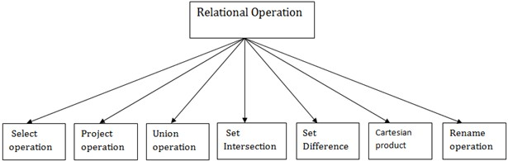
Relational Algebra
Relational algebra is a procedural query language. It gives a step-by-step process to
obtain the result of the query. It uses operators to perform queries.
Types of Relational operation

Slide 5
Relational Algebra Overview
Relational Algebra consists of several groups of operations
Unary Relational Operations
SELECTION (symbol: σ (sigma)) 2) PROJECTION (symbol: π (pi))
3) RENAME (symbol: ρ (rho))
Relational Algebra Operations From Set Theory
1) UNION (𝖴 ) 2) INTERSECTION ( ∩ ) 3) DIFFERENCE (or MINUS, – )
4) CARTESIAN PRODUCT ( x )
Binary Relational Operations
1) JOIN (several variations of JOIN exist) 2) DIVISION
Additional Relational Operations
OUTER JOINS
2) AGGREGATE FUNCTIONS (These compute summary of information: for example, SUM, COUNT, AVG, MIN, MAX)

Slide 6
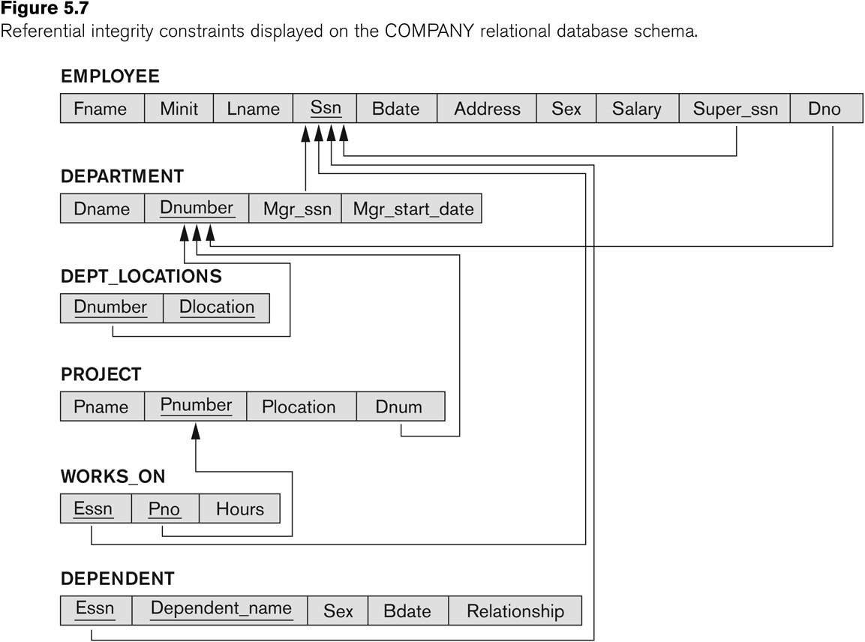
Database State for COMPANY
All examples discussed below refer to the COMPANY database shown here.

Slide 7
Unary Relational Operations: SELECT
The SELECT operation (denoted by σ (sigma)) is used to select a subset of the tuples from a relation based on a selection condition.
The selection condition acts as a filter
Keeps only those tuples that satisfy the qualifying condition
Tuples satisfying the condition are selected whereas the other tuples are discarded (filtered out)
Examples:
Select the EMPLOYEE tuples whose department number is 4:
σ _{DNO = 4} (EMPLOYEE)
Select the employee tuples whose salary is greater than $30,000:
σ SALARY > 30,000 ^{(EMPLOYEE)}

Slide 8
Unary Relational Operations: SELECT
In general, the select operation is denoted by σ <selection condition>(R) where the symbol σ (sigma) is used to denote the select operator.
The selection condition is a Boolean (conditional) expression specified on the attributes of relation R
Tuples that make the condition true are selected
appear in the result of the operation T
Tuples that make the condition false are filtered out
discarded from the result of the operation

Slide 9
Select Operation (Continue)
BRANCH_NAME | LOAN_NO | AMOUNT
Downtown | L-17 | 1000
Redwood | L-23 | 2000
Perryride | L-15 | 1500
Downtown | L-14 | 1500
Mianus | L-13 | 500
Roundhill | L-11 | 900
Perryride | L-16 | 1300
Input:
1. σ BRANCH_NAME="perryride" (LOAN)
Output:
BRANCH_NAME | LOAN_NO | AMOUNT
Perryride | L-15 | 1500
Perryride | L-16 | 1300

Slide 10
Unary Relational Operations: SELECT(cont)
SELECT Operation Properties
The SELECT operation σ _{<selection condition>}(R) produces a relation S that has the same schema (same attributes) as R
SELECT σ is commutative: ^{σ} <condition1>^{(σ} < condition2> ^{(R)) = σ} <condition2> ^{(σ} < condition1> ^{(R))}
Because of commutativity property, a cascade (sequence) of SELECT operations may be applied in any order:
^{σ}<cond1>^{(σ}<cond2> ^{(σ}<cond3> ^{(R)) = σ}<cond2> ^{(σ}<cond3> ^{(σ}<cond1> ^{( R)))}
A cascade of SELECT operations may be replaced by a single selection with a conjunction of all the conditions:
^{σ}<cond1>^{(σ}< cond2> ^{(σ}<cond3>^{(R)) = σ} <cond1> AND < cond2> AND < cond3>^{(R)))}
The number of tuples in the result of a SELECT is less than (or equal to) the number of tuples in the input relation R

Slide 11
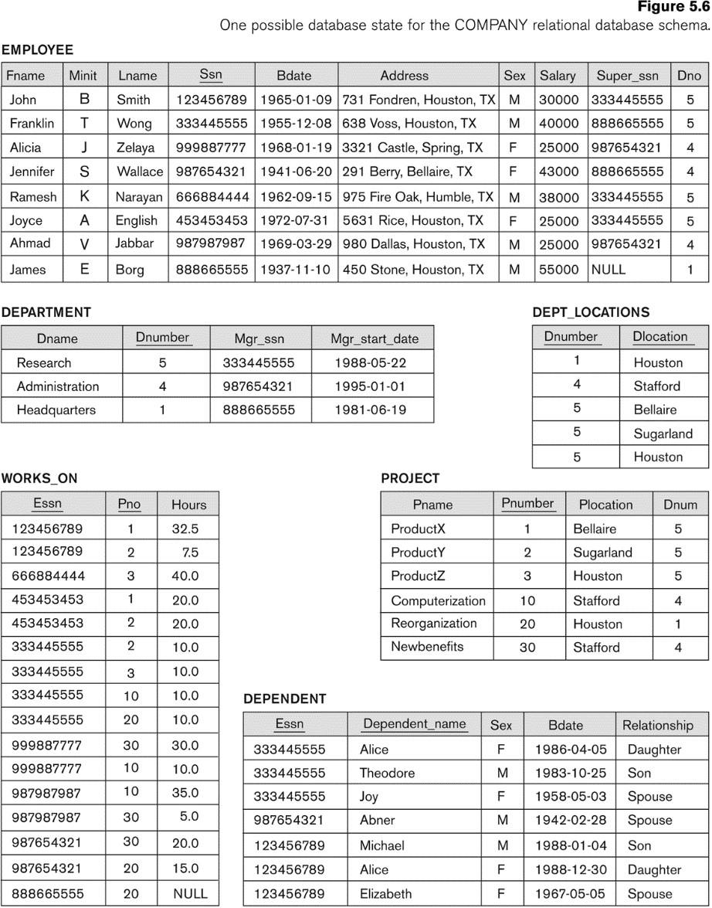
The following query results refer to this database state

Slide 12
Unary Relational Operations: PROJECT
PROJECT Operation is denoted by π (pi)
This operation keeps certain columns (attributes) from a relation and discards the other columns.
PROJECT creates a vertical partitioning
The list of specified columns (attributes) is kept in each tuple
The other attributes in each tuple are discarded
Example: To list each employee’s first and last name and salary, the following is used:
^{π}LNAME, FNAME,SALARY^{(EMPLOYEE)}

Slide 13
Unary Relational Operations: PROJECT (cont.)
The general form of the project operation is:
^{π}<attribute list>^{(R)}
π (pi) is the symbol used to represent the project operation
<attribute list> is the desired list of attributes from relation R.
The project operation removes any duplicate tuples
This is because the result of the project operation must be a set of tuples
Mathematical sets do not allow duplicate elements.

Slide 14
Project Operation (Continue)
Example: CUSTOMER RELATION
NAME | STREET | CITY
Jones | Main | Harrison
Smith | North | Rye
Hays | Main | Harrison
Curry | North | Rye
Johnson | Alma | Brooklyn
Brooks | Senator | Brooklyn
Output:
NAME | CITY
Jones | Harrison
Smith | Rye
Hays | Harrison
Curry | Rye
Johnson | Brooklyn
Brooks | Brooklyn
Input:
∏ NAME, CITY (CUSTOMER)

Slide 15
Unary Relational Operations: PROJECT (contd.)
PROJECT Operation Properties
The number of tuples in the result of projection π_{<list>}(R) is always less or equal to the number of tuples in R
If the list of attributes includes a key of R, then the number of tuples in the result of PROJECT is equal to the number of tuples in R
PROJECT is not commutative
π _{<list1>} (π _{<list2>} (R) ) = π _{<list1>} (R) as long as <list2> contains the attributes in <list1>

Slide 16
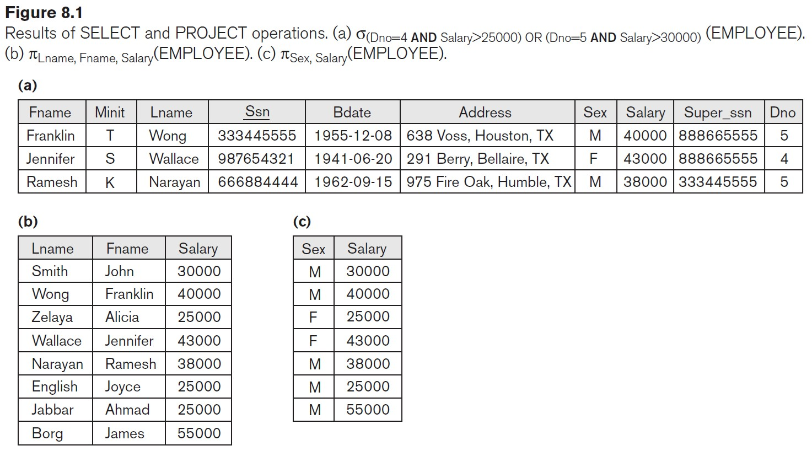
Examples of applying SELECT and PROJECT operations

Slide 17
Relational Algebra Expressions
We may want to apply several relational algebra operations one after the other
Either we can write the operations as a single relational algebra expression by nesting the operations, or
We can apply one operation at a time and create intermediate result relations.
In the latter case, we must give names to the relations that hold the intermediate results.

Slide 18
Single expression versus sequence of relational operations (Example)
To retrieve the first name, last name, and salary of all employees who work in department number 5, we must apply a select and a project operation
We can write a single relational algebra expression as follows:
^{π}FNAME, LNAME, SALARY^{(σ} DNO=5^{(EMPLOYEE))-----} Inline Expressions
OR We can explicitly show the sequence of operations, giving a name to each intermediate relation:
DEP5_EMPS ← σ _{DNO=5}(EMPLOYEE)
RESULT ← π _{FNAME, LNAME, SALARY} (DEP5_EMPS)

Slide 19
Unary Relational Operations: RENAME
The RENAME operator is denoted by ρ (rho)
In some cases, we may want to rename the attributes of a relation or the relation's name or both
Useful when a query requires multiple operations
Necessary in some cases (see JOIN operation later)

Slide 20
Unary Relational Operations: RENAME (continued)
The general RENAME operation ρ can be expressed by any of the following forms:
ρ_{S (B1, B2, …, Bn )}(R) changes both:
the relation's name to S, and
the column (attribute) names to B1, B2, …..Bn
ρ_{S}(R) changes:
the relation's name only to S
ρ_{(B1, B2, …, Bn )}(R) changes:
the column (attribute) names only to B1, B2, …..Bn

Slide 21

Unary Relational Operations: RENAME (continued)
For convenience, we also use a shorthand for renaming attributes in an intermediate relation:
If we write:
RESULT ← π _{FNAME, LNAME, SALARY} (DEP5_EMPS)
RESULT will have the same attribute names as DEP5_EMPS (same attributes as EMPLOYEE)
Note: the ← symbol is an assignment operator

Slide 22
Rename Operation
Example: We can use the rename operator to rename STUDENT relation to STUDENT1. ρ(STUDENT1, STUDENT)
Example-1: Query to rename the relation Student as Male Student and the attributes of Student – RollNo, SName as (Sno, Name).
^{ρ} MaleStudent(Sno, Name) ^{π}RollNo, SName^{(σ}Condition^{(Student))}
Example-2:Query to rename the attributes Name, Age of table Department to A,B.
ρ _{(A, B)} (Department)
Example-3: Query to rename the table name Project to Pro and its attributes to P, Q, R.
ρ _{Pro(P, Q, R)} (Project)
Example-4: Query to rename the first attribute of the table Student with attributes A,
B, C to P.
ρ _{(P, B, C)} (Student)

Slide 23
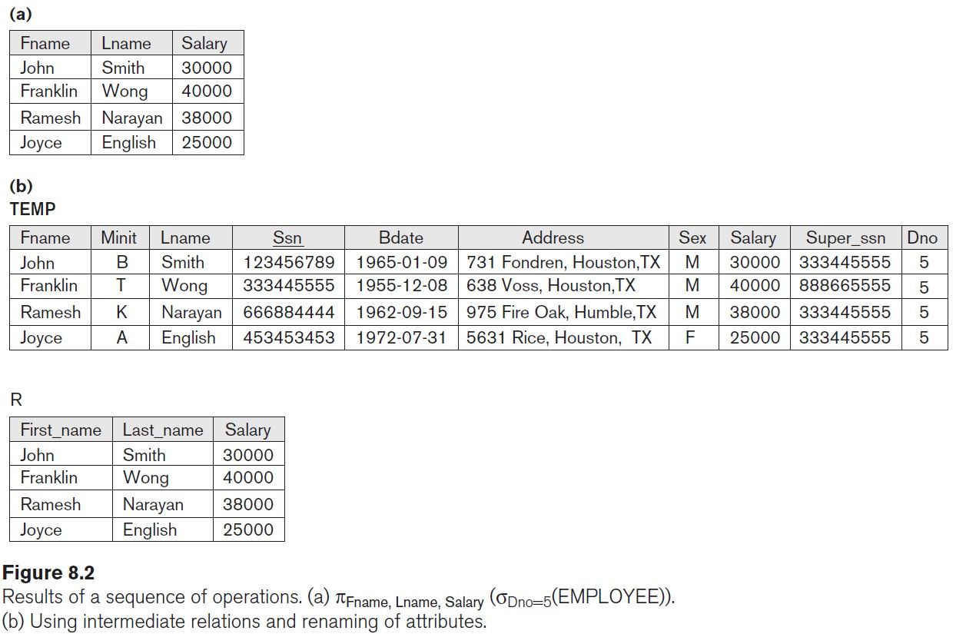
Example of applying multiple operations and RENAME

